Slide 1
Robust High-Dimensional Classification From Few Positive Examples
Deepayan Chakrabarti (deepay@utexas.edu)
https://github.com/deepayan12/direct

Slide 2
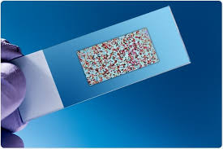
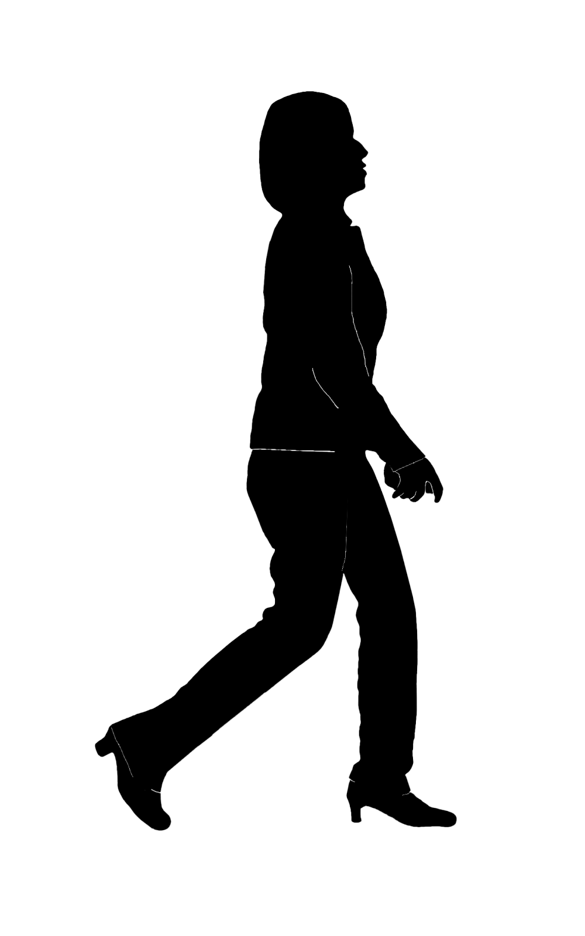
Tumor Classification From Genes
16,063 features (gene expressions)
Have Lung Cancer
Do not have Lung Cancer
How can we classify tumors from genes?

Slide 3
Document classification
O(100,000) keyword/bigram features
About a rare topic
Not about a rare topic
How can we identify topics for test documents?

Slide 4
Problem
Binary
High-dimensional Limited-data Imbalanced Classification
^
Existing approaches:
Modify the data: sample, then train
But samples built from limited data can be biased
Ensemble methods: many repetitions of the above
Can overfit due to limited data and high dimensionality
Cost-sensitive methods: modify the loss
Underperform for limited-size datasets [Cunha+/21]

Slide 5
Main Idea of DIRECT
Optimal separator
Difficulty
Minority class sample statistics are skewed
Naïve imbalanced separator

Slide 6
Main Idea of DIRECT
Difficulty
Minority class sample statistics are skewed
Sample covariance has too-small/zero variance along some directions [Marchenko+/67]
Need a better proxy for the minority class distribution
Sample covariance
Robust covariance
This is a more accurate covariance estimate
Sample covariance
Robust covariance
Smoothed kernel distribution

Slide 7
Main Idea of DIRECT
DIRECT’s separator
Difficulty
Minority class sample statistics are skewed
Sample covariance has too-small/zero variance along some directions
Need a better proxy for the minority class distribution
Kernel density using robust covariance
Sample covariance
Robust covariance
Smoothed kernel distribution
Optimize loss directly on smoothed distribution (no sampling)
Robust classifier

Slide 8
Steps
Parameter-free;
no user inputs needed
Parameters can be chosen optimally [Ledoit+/04]
Robust covariance
Smoothed kernel distribution
Direct optimization
Closed-form and convex for hinge loss
Max-entropy distribution, given mean & covariance
Optimizing over smooth kernel

Slide 9
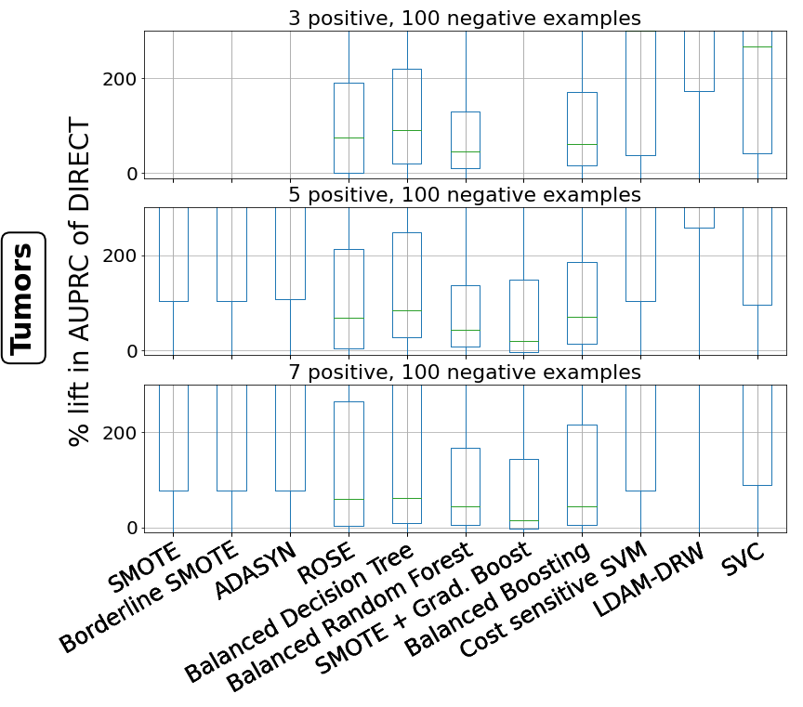
Experiments
Datasets
1 medical (16K features)
2 image
5 text (10K-100K features)
Metric: Area under the Precision-Recall curve

Slide 10
Conclusions
Binary
High-dimensional Limited-data Imbalanced Classification
^
DIRECT is fast, parameter-free, and accurate
https://github.com/deepayan12/direct

