Slide 1
Avoiding Biases due to Similarity Assumptions in Node Embeddings
Deepayan Chakrabarti (deepay@utexas.edu)
https://github.com/deepayan12/news

Slide 2
The Problem
2
Build node embeddings
1
Use as feature vectors
Classify
Recommend
Cluster
1
2
3
3
4
4
5
5
dim d
Adjacency matrix
N
Goal: build node embeddings
N

Slide 3
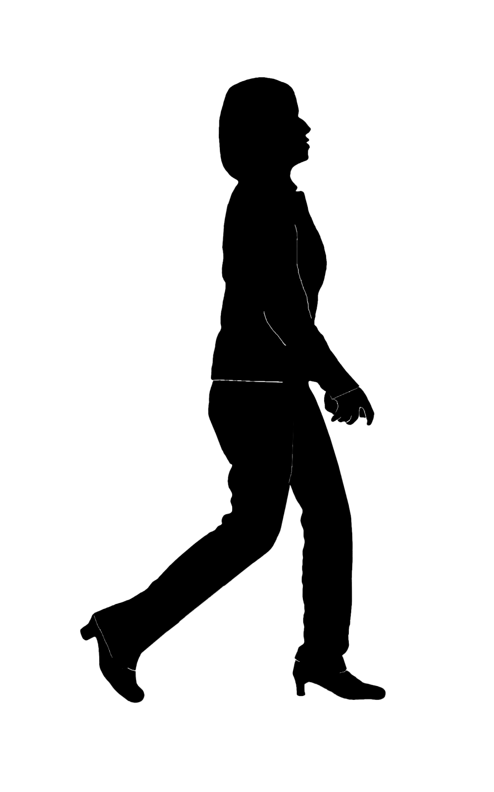
The Problem
People not connected to me
People connected to me
Me
My embedding
… “embeds” these classes
Goal: build personalized node embeddings

Slide 4
The Problem
Most nodes have low degrees
Number of nodes
Me
My embedding
Degree
Very few positive examples
Extreme class imbalance
Build personalized node embeddings under constraints

Slide 5
Existing methods
Grow the (+)ve class
We must assume a similarity metric
Assumed links to “similar” nodes
Me
My embedding
Very few positive examples
Extreme class imbalance

Slide 6
Weaknesses of Assumptions
Hidden biases
The embedding reflects these biases
➔ possibly poor-quality/unfair for some groups
Similarity from commute-time or hitting-time…
… just creates links to high-degree nodes [von Luxburg+/2014]

Slide 7
Weaknesses of Assumptions
Hidden biases
May not match intuition
Similarity via shared friends
➔ Intuitive for social networks
➔ Peer-to-peer lending networks?
?

Slide 8
Weaknesses of Assumptions
Hidden biases
May not match intuition
Similarity via shared friends
➔ Intuitive for social networks
➔ Peer-to-peer lending networks? ➔ Airport networks?
Austin
?
New York
Dallas
Houston
Chicago
Amsterdam

Slide 9
Weaknesses of Assumptions
Hidden biases
May not match intuition
Costly updates
Me

Slide 10
Weaknesses of Assumptions
Hidden biases
May not match intuition
Costly updates
Small network changes ➔ large updates
Cannot be done solely via existing embeddings
Me

Slide 11
Our Specific Problem
People not connected to me
People connected to me
Me
My embedding
… “embeds” these classes
Goal: build personalized node embeddings
without similarity assumptions

Slide 12
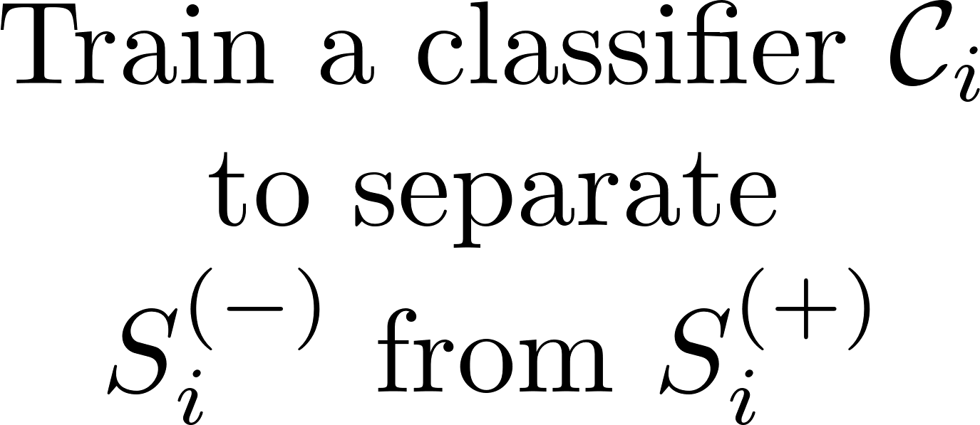
Our Method (NEWS)
?

Slide 13
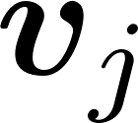
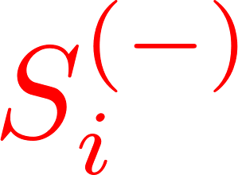
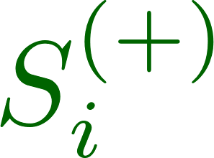
Our Method (NEWS)

Slide 14
Our Method (NEWS)
Minority class sample statistics are unreliable
Sample covariance
Sample covariance
Robust covariance
Robust covariance
Smooth distribution
This is a more accurate covariance estimate

Slide 15
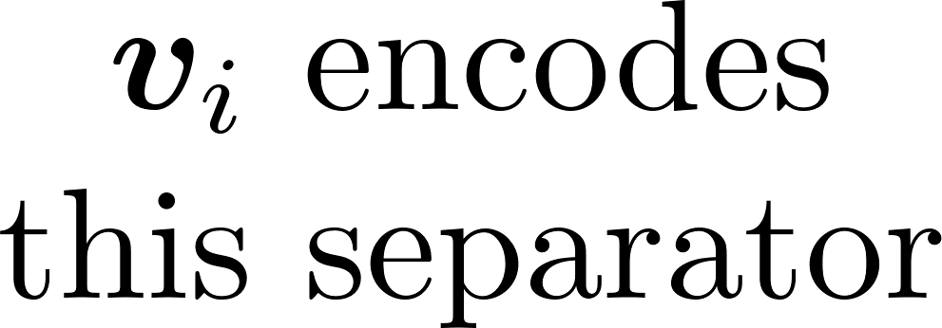
Our Method (NEWS)
Minority class sample statistics are unreliable
Sample covariance
Kernel density using robust covariance
Robust covariance
Smooth distribution
Optimize loss directly on smoothed distribution (no sampling)

Slide 16
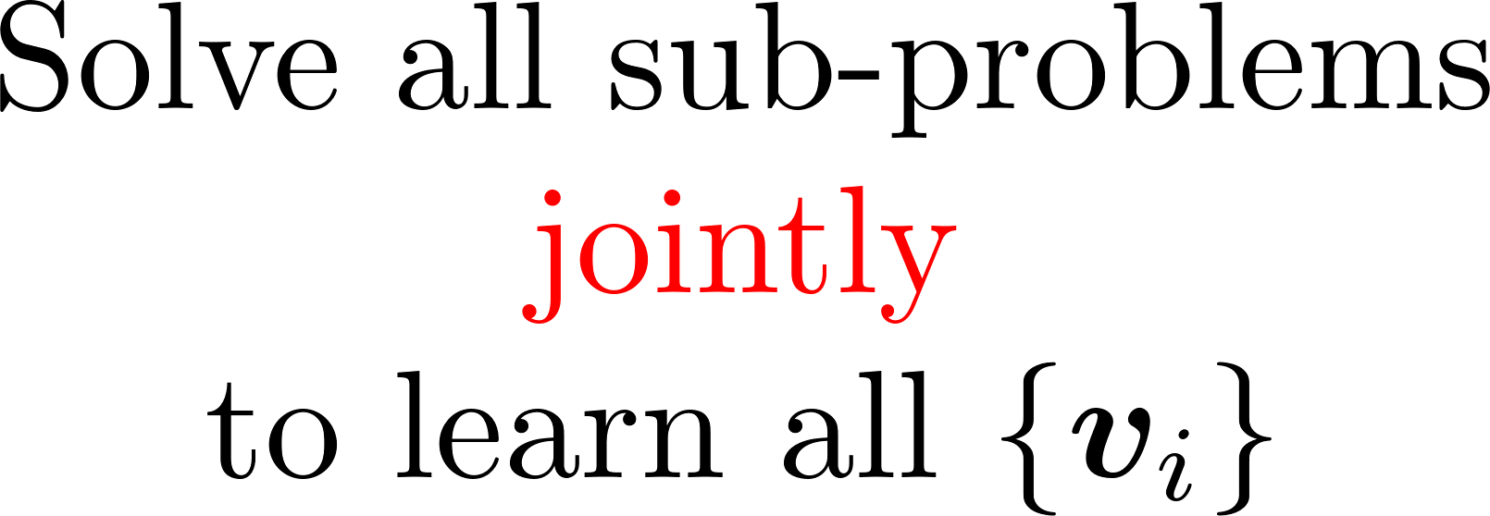
Our Method (NEWS)

Slide 17
Experiments
21 real-world networks
Social, citation, collaboration, financial, biological
… and others
Tasks
Link prediction
Node classification

Slide 18
Accuracy vs. degree
Energy-based
Matrix-based
Random walks
Auto-encoder
NEWS works well for all degrees
Metric = Area under the Precision-Recall curve

Slide 19
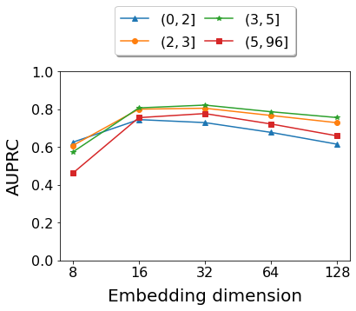
Robustness of NEWS
NEWS resists overfitting even for low-degree nodes
Arxiv (Condensed Matter) network

Slide 20
Conclusions
Node Embeddings Without Similarity Assumptions (NEWS)
Robust to limited data
Personalized
Parameter-free
https://github.com/deepayan12/news

Slide 21
Our Method (NEWS)
Celebrity “bias”
Interest vector

Slide 22
Troubling Assumptions
Hidden biases
May not match intuition
Expensive updates
A single link failure ➔ many changed similarities ➔ costly re-computation
X

Slide 23
Our Method (NEWS)
Minority class sample statistics are unreliable
Sample covariance
Sample covariance
Robust covariance
Robust covariance
Smooth distribution
This is a more accurate covariance estimate

