Slide 1
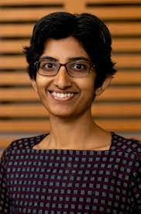
On Scalable Estimation for Overlapping Clustering Models
Deepayan Chakrabarti
Xueyu Mao
Purnamrita Sarkar

Slide 2
The Network Inference Problem
?
0.1 0.7 0.2
0.3 0.3 0.4
0.9 0.1 0.0
Social network
Community memberships
Personalized recommendations

Slide 3
The Network Inference Problem
0.1 0.7 0.2
model
0.3 0.3 0.4
0.9 0.1 0.0
Community memberships matrix
Social network
Latent variable inference
observed
latent

Slide 4
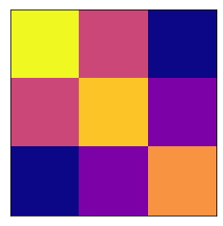
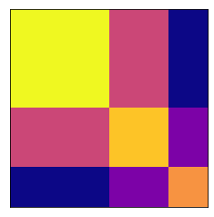
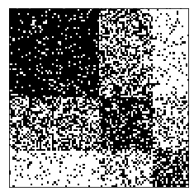
Models
Community connections B
Sparsity parameter
i
j
Binary community memberships
Connection probabilities P
Network Adjacency matrix A
Stochastic Blockmodel
[Holland+, ‘83]

Slide 5
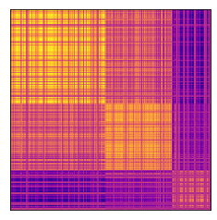
Models
Community connections B
Fractional community memberships
Connection probabilities P
Network Adjacency matrix A
Mixed-Membership Stochastic Blockmodel
[Airoldi+, ‘08]

Slide 6
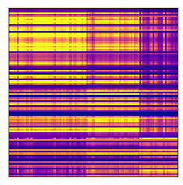
Models
Community connections B
“degree” parameters d
Fractional community memberships
Connection probabilities P
Network Adjacency matrix A
Degree-Corrected Mixed-Membership Stochastic Blockmodel
[Jin+, ‘17]

Slide 7
The Network Inference Problem
Unknown ordering of nodes (i.e., rows & columns)
“degree” parameters
Community connections
Network Adjacency matrix A
Fractional community memberships
Connection probabilities P
by-products

Slide 8
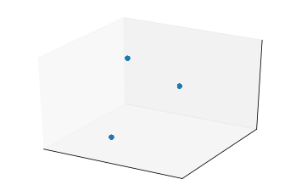
Background: spectral methods
Stochastic Blockmodel
=
Connection probabilities P
Plot of rows of U
[Ng+, ‘02; Qin+, ’13]

Slide 9
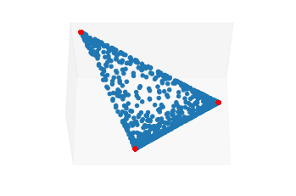
Background: spectral methods
Mixed-Membership Stochastic Blockmodel
=
Connection probabilities P
Plot of rows of U
[Anandkumar+, ‘14 , Mao+, ‘17; Jin+, ’17; Panov+, ’17, Rubin-Delanchy+, ‘17]

Slide 10
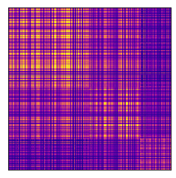
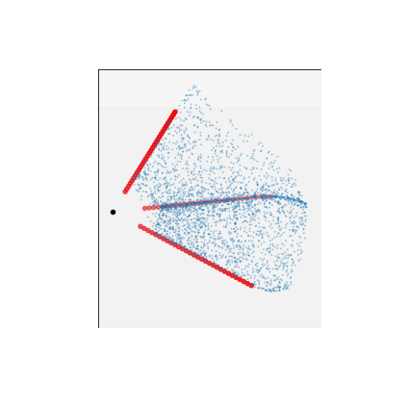
The general case
Degree-Corrected Mixed-Membership Stochastic Blockmodel
=
Connection probabilities P
Plot of rows of U

Slide 11
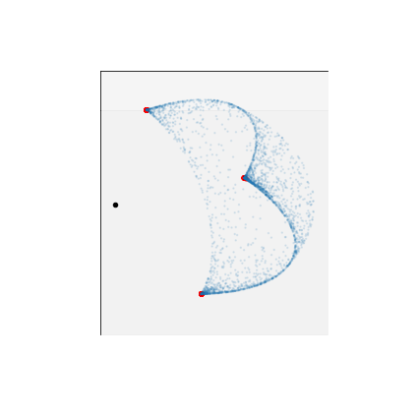
Inferring community memberships
How do we find the corner rays?
Project points to unit sphere
Solve a one-class SVM
All points are “positive”
Origin is “negative”
Find separating hyperplane

Slide 12
Inferring community memberships
Support vectors = corners

Slide 13
Algorithm
=
Connection probabilities P

Slide 14
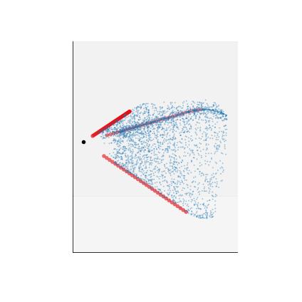
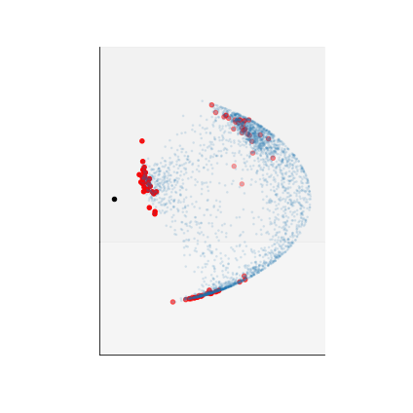
Algorithm
=
Adjacency matrix A
Cluster “nearly” support vectors
Use cluster centers as corners

Slide 15
Consistency
≈ Expected degree
The algorithm applies to other models too, with similar guarantees
OCCAM [Zhang/Levina/Zhu, ‘14]
LDA [Blei/Ng/Jordan, ‘03]
[Kaufman/Bonald/Lelarge, ’16]
Jin/Ke/Luo have independent work with similar guarantees

Slide 16
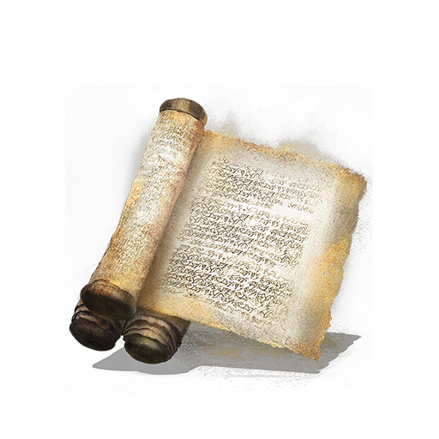
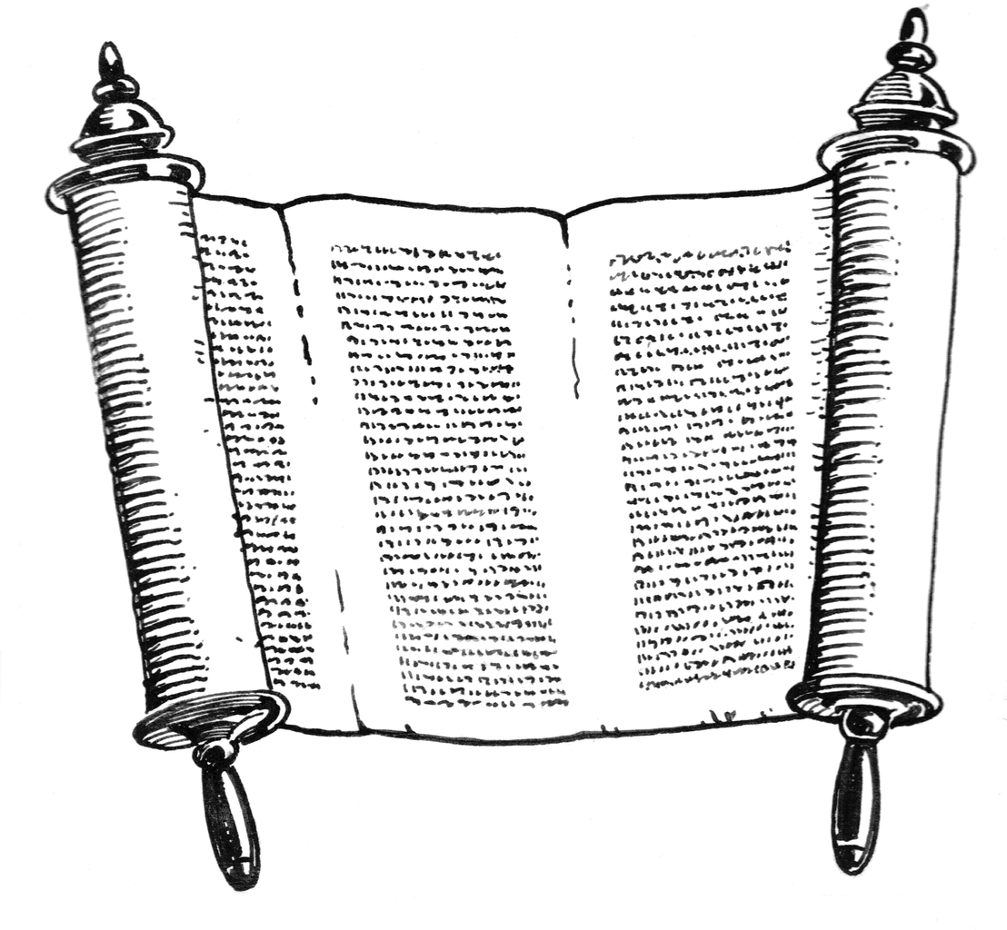
Experiments
Fraction of papers in different research areas
0.0 0.0 1.0 0.0
0.3 0.3 0.4
Paper communities
0.9 0.1 0.0
0.1 0.7 0.2
0.9 0.1 0.0 0.0
Author communities
0.7 0.1 0.2
0.2 0.8 0.0
DBLP Co-authorship network
DBLP author-paper network

Slide 17
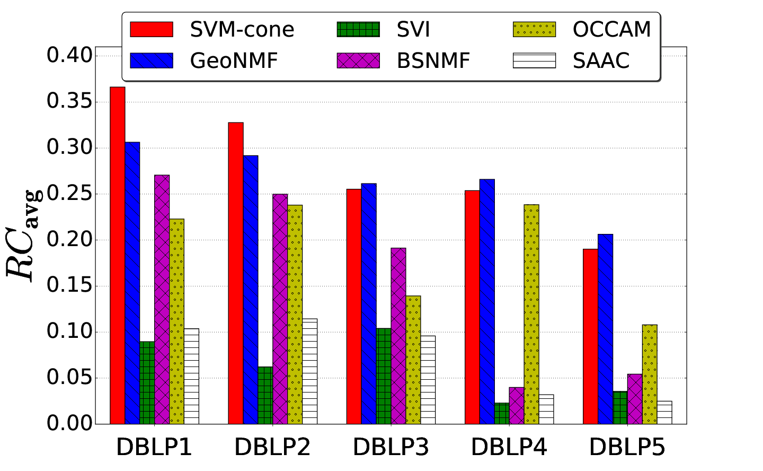
Experiments
Accuracy
Co-authorship network

Slide 18
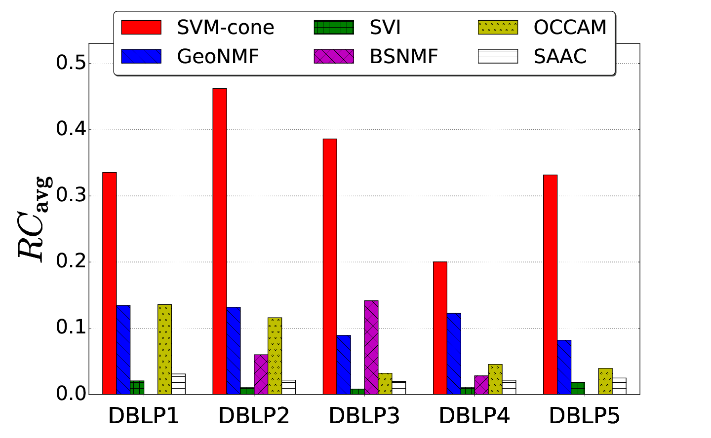
Experiments
Accuracy
Author-paper bipartite network

Slide 19
Conclusion
?
0.1 0.7 0.2
0.3 0.3 0.4
0.9 0.1 0.0
Community memberships
Social network
Model
probability is bilinear in latent variables
Algorithm
one-class SVM on row-normalized eigenvectors

Slide 20
Details

