Slide 1
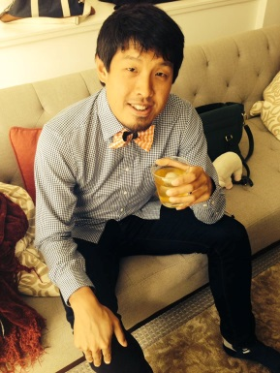
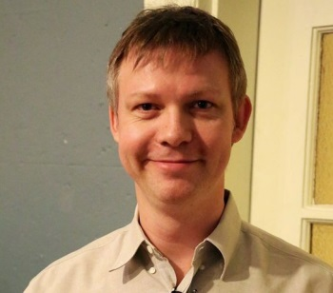
Joint Inference of Multiple Label Types in Large Networks
Stanislav Funiak (sfuniak@fb.com)
Jonathan Chang (jonchang@fb.com)
Sofus A. Macskassy (sofmac@fb.com)
Deepayan Chakrabarti (deepay@fb.com)

Slide 2
Profile Inference
Profile:
Hometown: Palo Alto
High School: Gunn
College: Stanford
Employer: Facebook
Current city: Sunnyvale
Hobbies, Politics, Music, …
A complete profile is a boon:
People are easily searchable
Tailored news recommendations
Group recommendations
Ad targeting (especially local)
How can we fill in missing profile fields?
?
?
?

Slide 3
Profile Inference
Use the social network
and the assumption of homophily
Friendships form between “similar” people
Infer missing labels to maximize similarity
H = Palo Alto E = Microsoft
H = ? E = ?
v₁
v₃
H = Palo Alto E = ?
H = ? E = ?
u
v₂
v₄
v₅
H = Atlanta E = Google
H = MPK E = FB

Slide 4
Previous Work
Random walks [Talukdar+/09, Baluja+/08]
Statistical Relational Learning [Lu+/03, Macskassy+/07]
Relational Dependency Networks [Neville+/07]
Latent models [Palla+/12]
Either:
too generic; require too much labeled data;
do not handle multiple label types;
are outperformed by label propagation [Macskassy+/07]

Slide 5
Previous Work
Label Propagation [Zhu+/02, Macskassy+/07]
“Propagate” labels through the network
Probability (I have hometown H) = fraction of my friends whose hometown is H
Iterate until convergence
Repeat for current city, college, and all other label types
H = Palo Alto (…) MPK (…) Atlanta (…)
H = Palo Alto
v₁
v₃
u
H = Palo Alto (0.5) MPK (0.25) Atlanta (0.25)
H = Palo Alto
H = ?
v₂
v₄
v₅
H = Atlanta
H = MPK

Slide 6
Problem
H = Calcutta CC = Bangalore
CC = Berkeley
u
H = ? CC = ?
H = Calcutta
CC = Bangalore
H = Calcutta
Interactions between label types are not considered

Slide 7
The EdgeExplain Model
Instead of taking friendships as given, explain friendships using labels
A friendship u∼v is explained if: u and v share the same hometown OR current city OR high school OR college OR employer

Slide 8
The EdgeExplain Model
H = Calcutta CC = Bangalore
Hometown friends
CC = Berkeley
Current City friends
u
H = ? CC = ?
H = Calcutta
CC = Berkeley
H = Calcutta
We set H and CC so as to jointly explain all friendships

Slide 9
The EdgeExplain Model
Find f to maximize ∏explained (f_{u}, f_{v})
“Soft” OR over label types
u∼v
Explain all friendships
Probability distribution for each label type

Slide 10
The EdgeExplain Model
Find f to maximize ∏explained (f_{u}, f_{v})
“Soft” OR over label types
u∼v
explained (f_{u}, f_{v}) = softmax( is_reason_{t} (f_{ut}, f_{vt}) )
Is u∼v explained by label type t?
t∊Τ
is_reason_{t} (f_{ut}, f_{vt}) = ∑ f_{utℓ} . f_{vtℓ}
Chances of sharing a label of type t
ℓ∊L(t)
softmax( is_reason_{t} (f_{ut}, f_{vt}) ) = σ (α . ∑ is_reason_{t} (f_{ut}, f_{vt}) + c)
Sigmoid for softmax
t∊Τ
t∊Τ

Slide 11
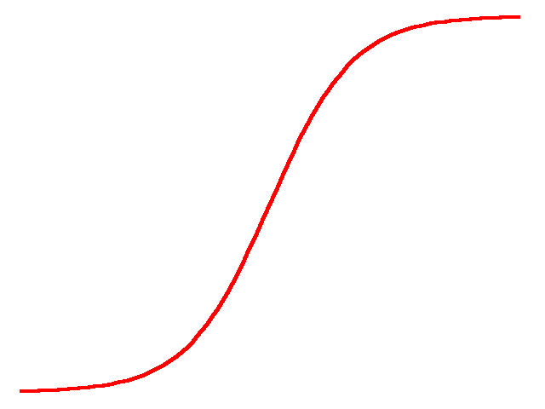
The EdgeExplain Model
softmax( is_reason_{t} (f_{ut}, f_{vt}) ) = σ (α . ∑ is_reason_{t} (f_{ut}, f_{vt}) + c)
∑_{t} is_reason_{t}
∑_{t} is_reason_{t}
H = Calcutta CC = Bangalore
CC = Berkeley
u
H = ? CC = ?
H = Calcutta

Slide 12
The EdgeExplain Model
softmax( is_reason_{t} (f_{ut}, f_{vt}) ) = σ (α . ∑ is_reason_{t} (f_{ut}, f_{vt}) + c)
∑_{t} is_reason_{t}
H=Cal
∑_{t} is_reason_{t}
H=Cal
H = Calcutta CC = Bangalore
CC = Berkeley
u
H = Calcutta CC = ?
H = Calcutta

Slide 13
The EdgeExplain Model
softmax( is_reason_{t} (f_{ut}, f_{vt}) ) = σ (α . ∑ is_reason_{t} (f_{ut}, f_{vt}) + c)
Marginal gain with CC = Bangalore
H=Cal
H=Cal CC=B’lore
H=Cal CC=B’lore
∑_{t} is_reason_{t}
∑_{t} is_reason_{t}
H=Cal
H = Calcutta CC = Bangalore
CC = Berkeley
u
H = Calcutta CC = Bangalore
H = Calcutta

Slide 14
The EdgeExplain Model
softmax( is_reason_{t} (f_{ut}, f_{vt}) ) = σ (α . ∑ is_reason_{t} (f_{ut}, f_{vt}) + c)
More gain with CC = Berkeley
H=Cal CC=Berkeley
∑_{t} is_reason_{t}
H=Cal
∑_{t} is_reason_{t}
H=Cal
H=Cal CC=Berkeley
H = Calcutta CC = Bangalore
CC = Berkeley
u
H = Calcutta CC = Berkeley
H = Calcutta

Slide 15
The EdgeExplain Model
softmax( is_reason_{t} (f_{ut}, f_{vt}) ) = σ (α . ∑ is_reason_{t} (f_{ut}, f_{vt}) + c)
α controls the slope
high α ➔ steep ➔ one reason per edge is enough
low α ➔ linear ➔ consider multiple reasons per edge
H=Cal CC=Berkeley
∑_{t} is_reason_{t}
H=Cal
∑_{t} is_reason_{t}
H=Cal
H=Cal CC=Berkeley

Slide 16
Experiments
1.1B users of the Facebook social network
O(10M) labels
5-fold cross-validation
Measure recall
Did we get the correct label in our top prediction? Top-3?
Inference:
proximal gradient descent
implemented via message-passing in Apache Giraph [Ching/13]
Sparsify graph by considering K closest friends by age

Slide 17
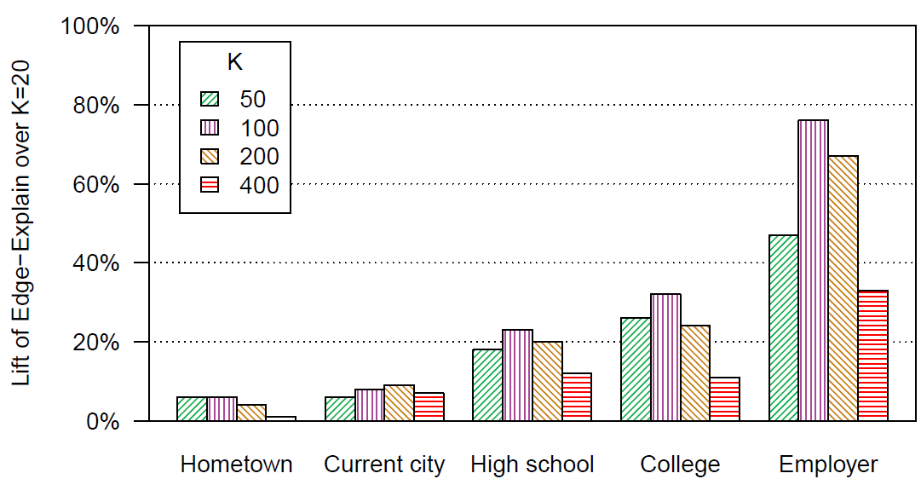
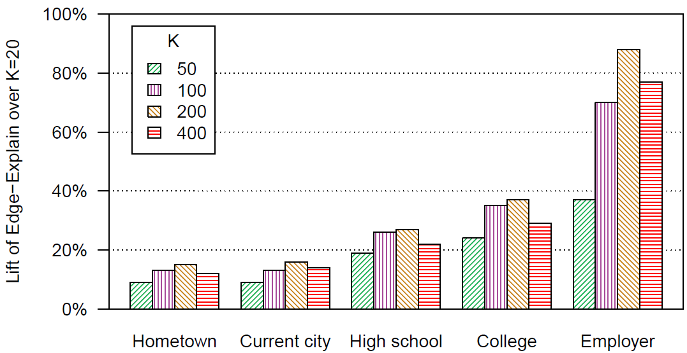
Results (varying closest friends K)
K=100 or K=200 closest friends is best
K=400 hurts; these friendships are probably due to other factors
Lift of EdgeExplain over K=20
Lift of EdgeExplain over K=20
Hometown
High school
College
Employer
Hometown
Current city
High school
College
Employer
Current city
Recall@1
Recall@3

Slide 18
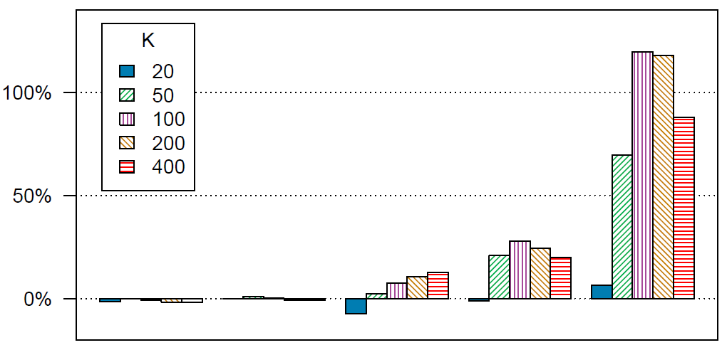
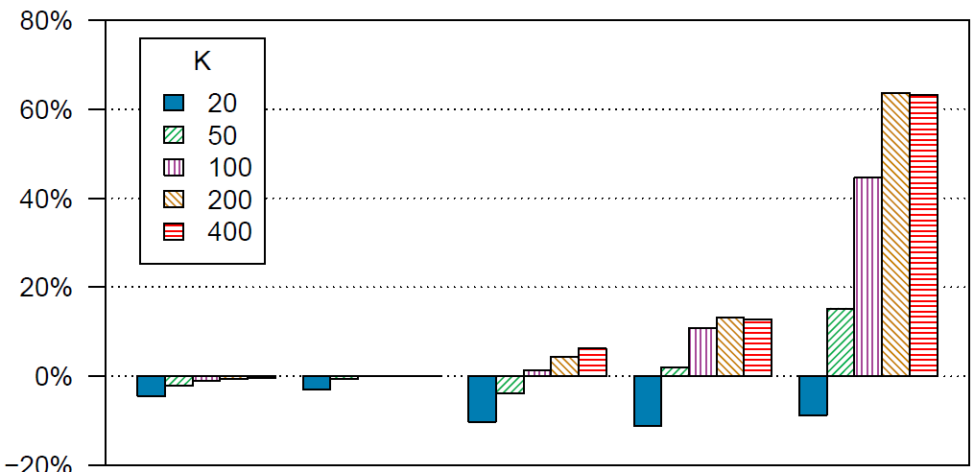
Results (versus Label Propagation)
Joint modeling helps most for employer
Significant gains for high school and college as well
Lift of EdgeExplain over Label Propagation
Lift of EdgeExplain over Label Propagation
Hometown
Current city
High school
College
Employer
Hometown
Current city
High school
College
Employer
Recall@1
Recall@3

Slide 19
Conclusions
Assumption: each friendship has one reason
Model: explain friendships via user attributes
Results: up to 120% lift for recall@1 and 60% for recall@3

Slide 20
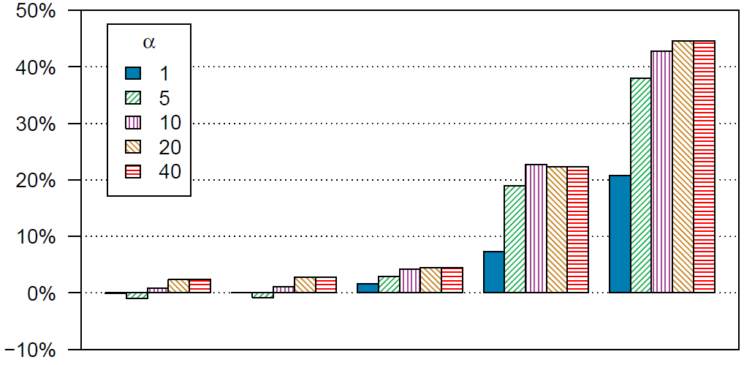
Result (effect of α)
High α is best ➔ one reason per friendship is enough
Lift of EdgeExplain over α=0.1
Hometown
College
Employer
Current city
High school

Slide 21
Results (varying closest friends K)
K=100 or K=200 closest friends is best
K=400 hurts; these friendships are probably due to other factors
Recall@1
Recall@3

Slide 22
Results (versus Label Propagation)
Joint modeling helps most for employer
Significant gains for high-school and college as well
Recall@1
Recall@3

Slide 23
Problem
Hometown friends, now in Bangalore
Friends in my current city
Hometown friends

